Slide 1


Caravel + Nucleo Board

Slide 2
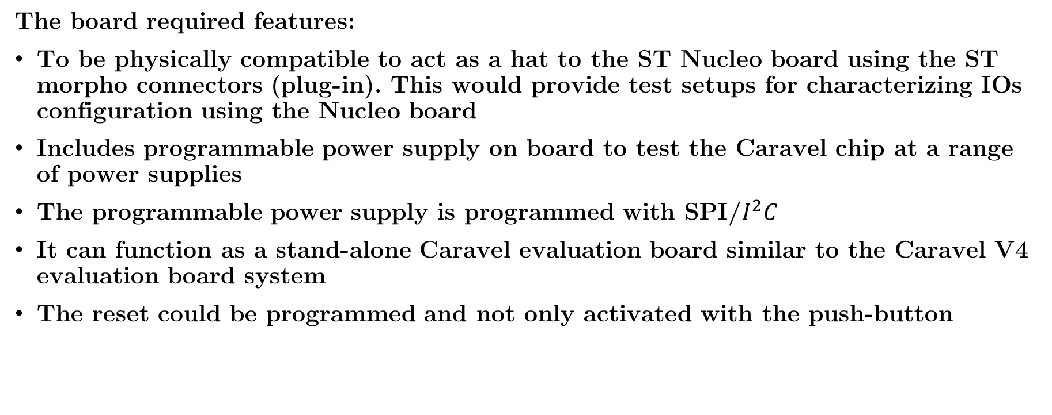
Specifications
The board required features:
To be physically compatible to act as a hat to the ST Nucleo board using the ST morpho connectors (plug-in). This would provide test setups for characterizing IOs configuration using the Nucleo board
Includes programmable power supply on board to test the Caravel chip at a range of power supplies
The programmable power supply is programmed with SPI/$I^{2}C$
It can function as a stand-alone Caravel evaluation board similar to the Caravel V4 evaluation board system
The reset could be programmed and not only activated with the push-button

Slide 3
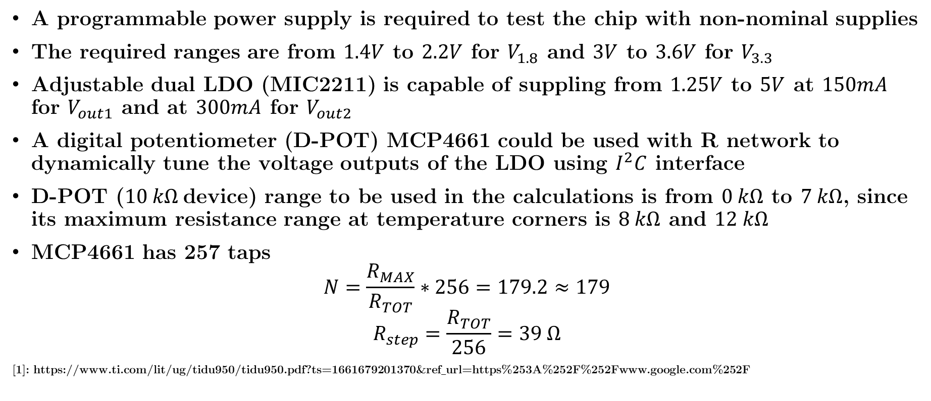
Programmable Power Supply
A programmable power supply is required to test the chip with non-nominal supplies
The required ranges are from $1.4V$ to $2.2V$ for $V_{1.8}$ and $3V$ to $3.6V$ for $V_{3.3}$
Adjustable dual LDO (MIC2211) is capable of suppling from $1.25V$ to $5V$ at $150mA$ for $V_{out1}$ and at $300mA$ for $V_{out2}$
A digital potentiometer (D-POT) MCP4661 could be used with R network to dynamically tune the voltage outputs of the LDO using $I^{2}C$ interface
D-POT ($10 kΩ$device) range to be used in the calculations is from $0 kΩ$ to $7 kΩ$, since its maximum resistance range at temperature corners is $8 kΩ$ and $12 kΩ$
MCP4661 has 257 taps
$$N=\frac{R_{MAX}}{R_{TOT}}∗256=179.2≈179$$
$$R_{step}=\frac{R_{TOT}}{256}=39 Ω$$
[1]: https://www.ti.com/lit/ug/tidu950/tidu950.pdf?ts=1661679201370&ref_url=https%253A%252F%252Fwww.google.com%252F

Slide 4




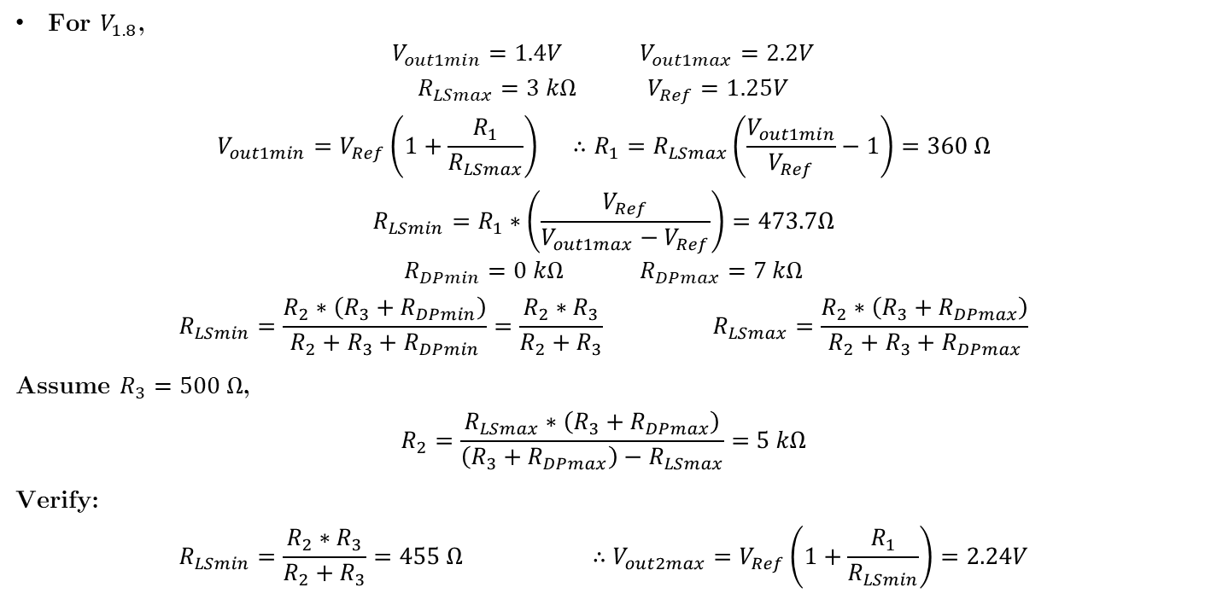




Resistance Calculations
For $V_{1.8}$,
$$V_{out1min}{=1.4V} V_{out1max}{=2.2V}$$
$$R_{LSmax}{=3 kΩ} V_{Ref}{=1.25V}$$
$$V_{out1min}{=V_{Ref}\left(1+\frac{R_{1}}{R_{LSmax}}\right) ∴R_{1}=R_{LSmax}\left(\frac{V_{out1min}}{V_{Ref}}−1\right)=360 Ω}$$
$$R_{LSmin}=R_{1}∗\left(\frac{V_{Ref}}{V_{out1max}−V_{Ref}}\right)=473.7Ω$$
$$R_{DPmin}{=0 kΩ}{ R}_{DPmax}{=7 kΩ}$$
$$R_{LSmin}=\frac{R_{2}∗\left(R_{3}+R_{DPmin}\right)}{R_{2}+R_{3}+R_{DPmin}}=\frac{R_{2}∗R_{3}}{R_{2}+R_{3}} R_{LSmax}=\frac{R_{2}∗\left(R_{3}+R_{DPmax}\right)}{R_{2}+R_{3}+R_{DPmax}}$$
Assume $R_{3}=500 Ω$,
$$R_{2}=\frac{R_{LSmax}∗\left(R_{3}+R_{DPmax}\right)}{\left(R_{3}+R_{DPmax}\right)−R_{LSmax}}=5 kΩ$$
Verify:
$$R_{LSmin}=\frac{R_{2}∗R_{3}}{R_{2}+R_{3}}=455 Ω ∴V_{out2max}{=V_{Ref}\left(1+\frac{R_{1}}{R_{LSmin}}\right)=2.24V}$$
Notes:
$V_{Ref}$ is from the adjustable dual LDO (MIC2211) datasheet
$R_{LSmax}$ is set to ensure loop stability, not sure of the basis of this value

Slide 5
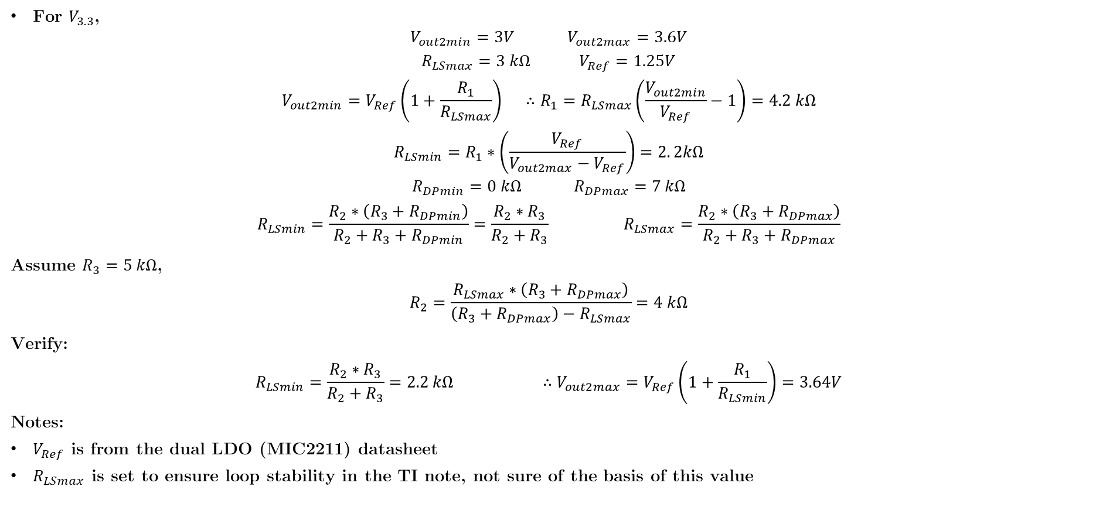
Resistance Calculations
For $V_{3.3}$,
$$V_{out2min}{=3V} V_{out2max}{=3.6V}$$
$$R_{LSmax}{=3 kΩ} V_{Ref}{=1.25V}$$
$$V_{out2min}{=V_{Ref}\left(1+\frac{R_{1}}{R_{LSmax}}\right) ∴R_{1}=R_{LSmax}\left(\frac{V_{out2min}}{V_{Ref}}−1\right)=4.2 kΩ}$$
$$R_{LSmin}=R_{1}∗\left(\frac{V_{Ref}}{V_{out2max}−V_{Ref}}\right)=2. 2kΩ$$
$$R_{DPmin}{=0 kΩ}{ R}_{DPmax}{=7 kΩ}$$
$$R_{LSmin}=\frac{R_{2}∗\left(R_{3}+R_{DPmin}\right)}{R_{2}+R_{3}+R_{DPmin}}=\frac{R_{2}∗R_{3}}{R_{2}+R_{3}} R_{LSmax}=\frac{R_{2}∗\left(R_{3}+R_{DPmax}\right)}{R_{2}+R_{3}+R_{DPmax}}$$
Assume $R_{3}=5 kΩ$,
$$R_{2}=\frac{R_{LSmax}∗\left(R_{3}+R_{DPmax}\right)}{\left(R_{3}+R_{DPmax}\right)−R_{LSmax}}=4 kΩ$$
Verify:
$$R_{LSmin}=\frac{R_{2}∗R_{3}}{R_{2}+R_{3}}=2.2 kΩ ∴V_{out2max}{=V_{Ref}\left(1+\frac{R_{1}}{R_{LSmin}}\right)=3.64V}$$
Notes:
$V_{Ref}$ is from the dual LDO (MIC2211) datasheet
$R_{LSmax}$ is set to ensure loop stability in the TI note, not sure of the basis of this value

Slide 6

Resistance Calculations
For nominal supplies:
$$V_{out1}{=1.8V} V_{out2}{=3.3V}$$
$$R_{LS}={R_{1}∗\left(\frac{V_{Ref}}{{V_{out}−V}_{Ref}}\right)}$$
$${∴R}_{LS1}=818.2 Ω {∴R}_{LS2}=2.6 kΩ$$
$$R_{LS}=\frac{R_{2}∗\left(R_{3}+R_{DP}\right)}{R_{2}+R_{3}+R_{DP}} ∴R_{DP}=\frac{R_{LS}∗\left(R_{2}+R_{3}\right)−R_{2}R_{3}}{R_{2}−R_{LS}}$$
$${∴R}_{DP1}=478 Ω {∴R}_{DP2}=2. 4kΩ$$
$$R_{DP}=\frac{R_{TOT}N}{256}+R_{W} ∴N=\left(R_{DP}−R_{W}\right)∗\frac{256}{R_{TOT}}$$
$$R_{W}=75 Ω { R}_{TOT}=10 kΩ$$
$${∴N}_{1}=10.3≈11 \left(Bh\right) {∴N}_{2}=59.5≈60 (3Ch)$$

Slide 7
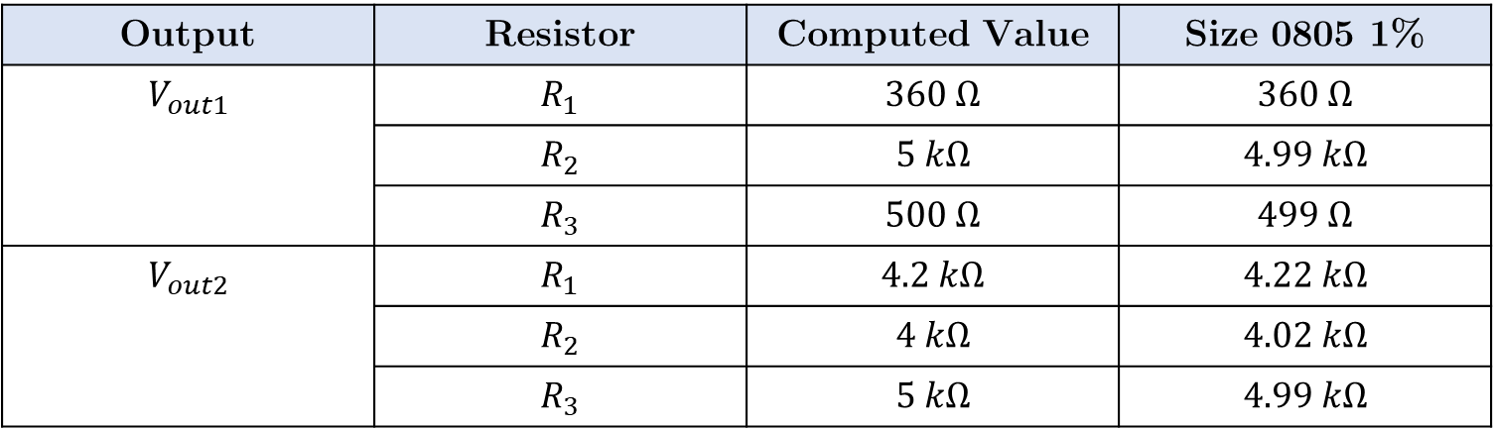
Resistors
Output | Resistor | Computed Value | Size 0805 1%
$$V_{out1}$$ | $$R_{1}$$ | $$360 Ω$$ | $$360 Ω$$
 | $$R_{2}$$ | $$5 kΩ$$ | $$4.99 kΩ$$
 | $$R_{3}$$ | $$500 Ω$$ | $$499 Ω$$
$$V_{out2}$$ | $$R_{1}$$ | $$4.2 kΩ$$ | $$4.22 kΩ$$
 | $$R_{2}$$ | $$4 kΩ$$ | $$4.02 kΩ$$
 | $$R_{3}$$ | $$5 kΩ$$ | $$4.99 kΩ$$
Notes:
MIC2211 datasheet recommends the resistor values should be between 100kΩ and 500kΩ to prevent compromising the low quiescent current performance. This can’t be achieved with the $R_{LSmax}$ assumption

Slide 8




Caravel Board V4 Block Diagram
USB Interface
Voltage Regulator
$5V$ Supply
$3.3V$ Supply
$1.8V$ Supply
Caravel BB
PoR
SPI
HKSPI/IO [1:4]
FTDI
$$\overline{RST}$$
Flash Memory
UART
Configure IOs
IO [5:6]
FLASH Interface
SPI
IO [0:37]
UART Enable

Slide 9
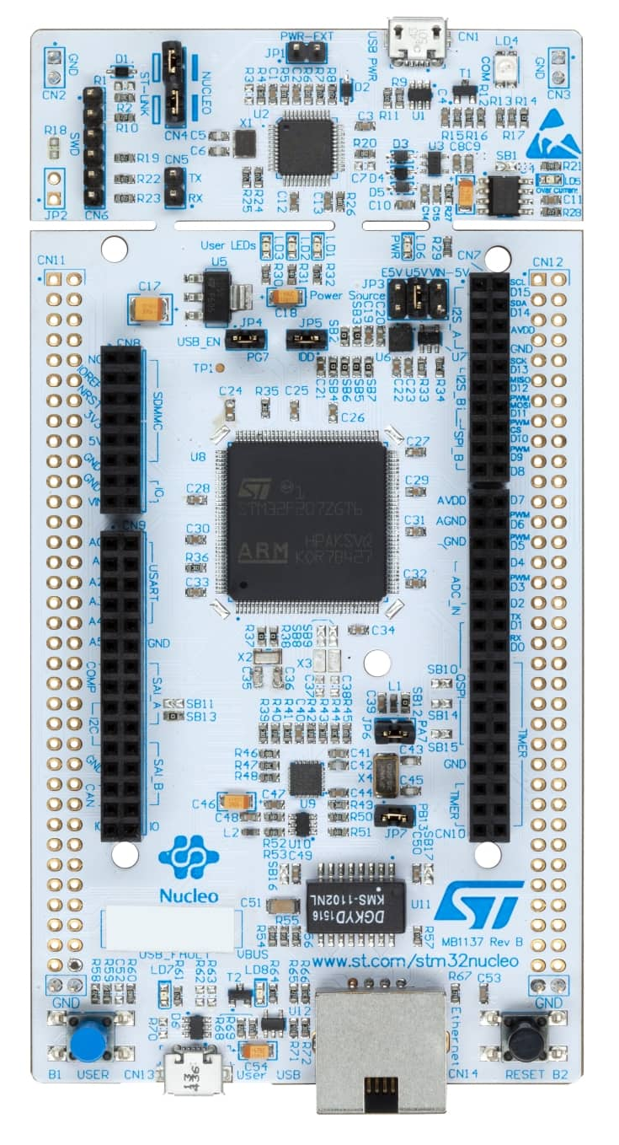
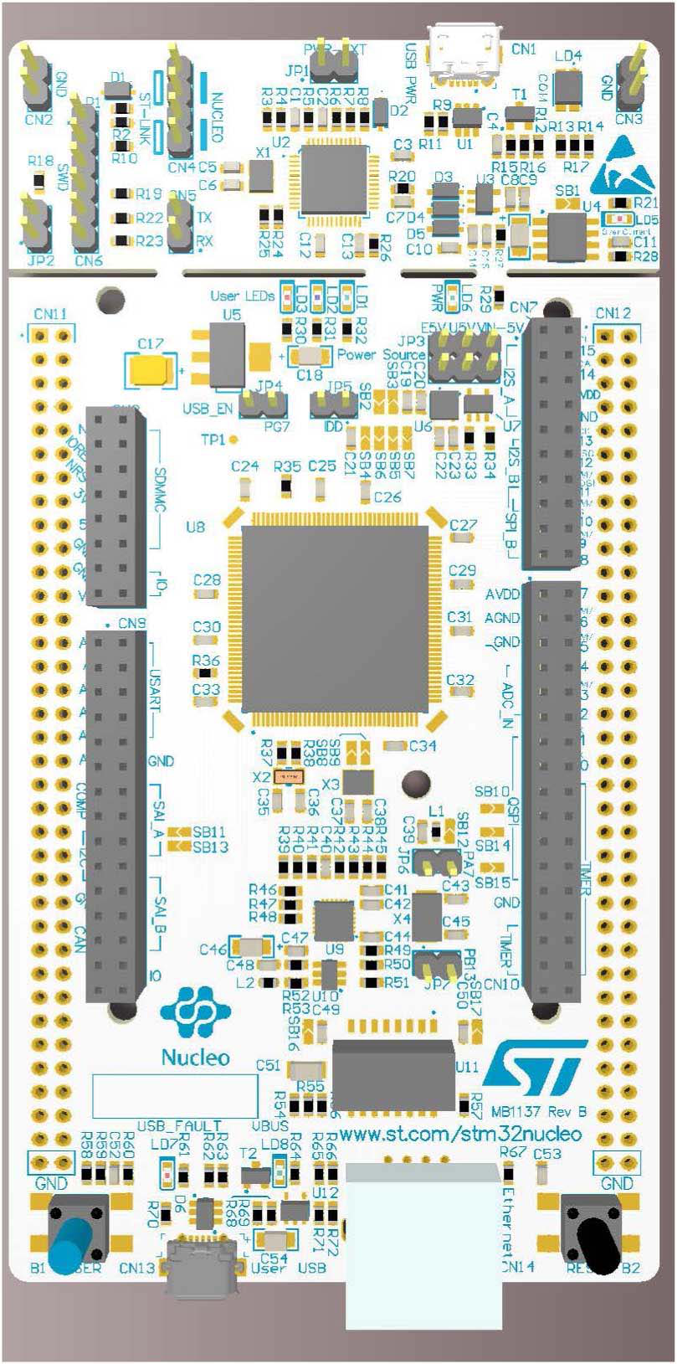
Nucleo Board: NUCLEO144-F746ZG
[2]: https://www.st.com/en/evaluation-tools/nucleo-F746ZG.html

Slide 10
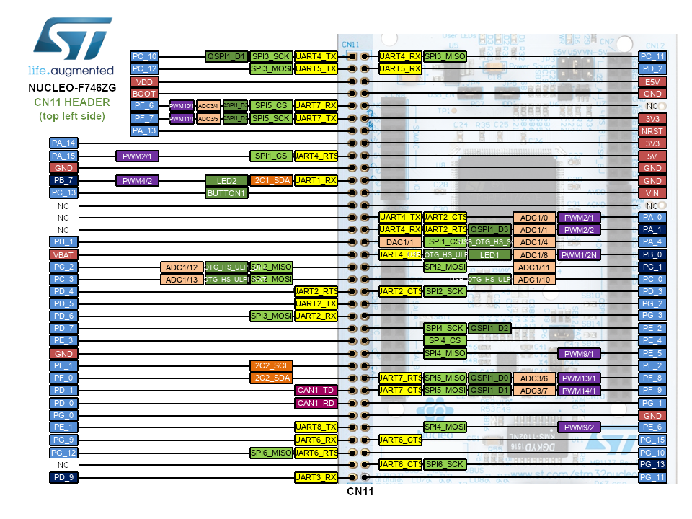
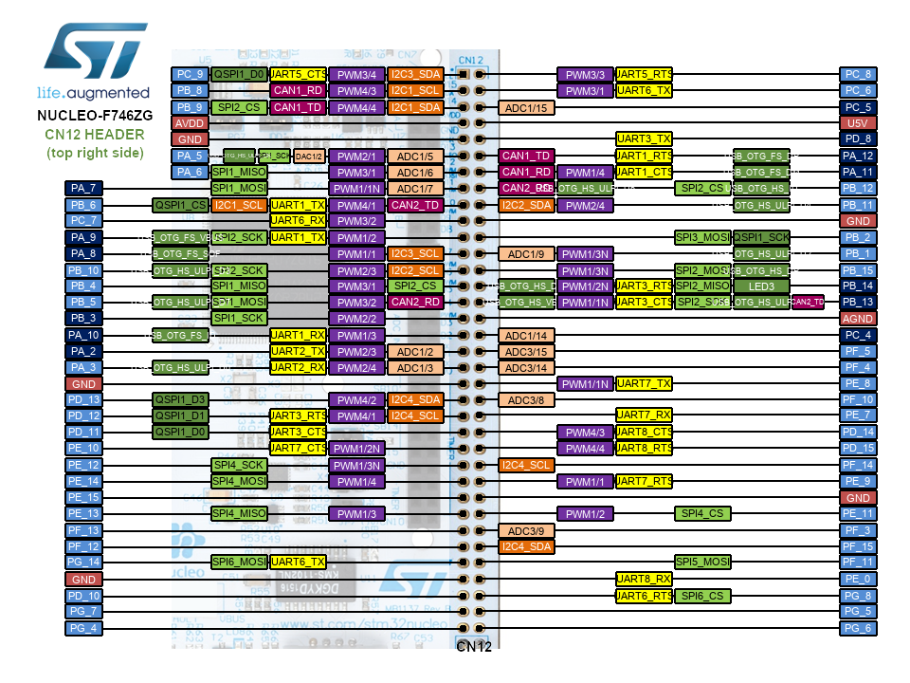
Nucleo Board: ST Morpho Connectors
[3]: https://os.mbed.com/platforms/ST-Nucleo-F746ZG/#board-pinout

Slide 11
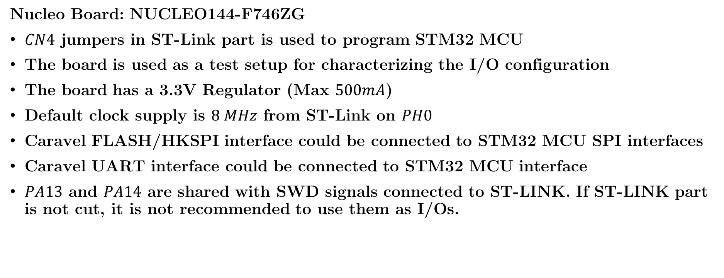
Nucleo Board: Interface with Caravel
Nucleo Board: NUCLEO144-F746ZG
$CN4$ jumpers in ST-Link part is used to program STM32 MCU
The board is used as a test setup for characterizing the I/O configuration
The board has a 3.3V Regulator (Max $500mA$)
Default clock supply is $8 MHz$ from ST-Link on $PH0$
Caravel FLASH/HKSPI interface could be connected to STM32 MCU SPI interfaces
Caravel UART interface could be connected to STM32 MCU interface
$PA13$ and $PA14$ are shared with SWD signals connected to ST-LINK. If ST-LINK part is not cut, it is not recommended to use them as I/Os.

Slide 12


















Caravel + Nucleo Board Block Diagram
Nucleo-144 Board
USB Interface
ST Morpho Connectors
Disable
$$5V$$
$$5V$$
$$I^{2}C$$
$$\overline{MR}$$
$$5V$$
$$V_{1.8}$$
$$V_{out1}$$
USB Interface
Voltage Regulator
Bridge
Adj Voltage regulator
$$V_{3.3}$$
$$V_{out2}$$
$$3.3V$$
Disable
$$V_{REF1}$$
$$V_{REF2}$$
FTDI Voltage Regulator
$$1.8V$$
$$3.3V$$
D-POT+R Network
FTDI
Caravel BB
SPI
IO [0:37] & FLASH
HKSPI/IO [1:4]
$$3.3V$$
SPI
Flash Memory
$$3.3V$$
UART
FLASH
IO [5:6]
IO [0:37]
$$3.3V$$
$$\overline{MR}$$
$$\overline{RST}$$
PoR
$$\overline{UART_EN}$$
Caravel Nucleo-Hat

Slide 13
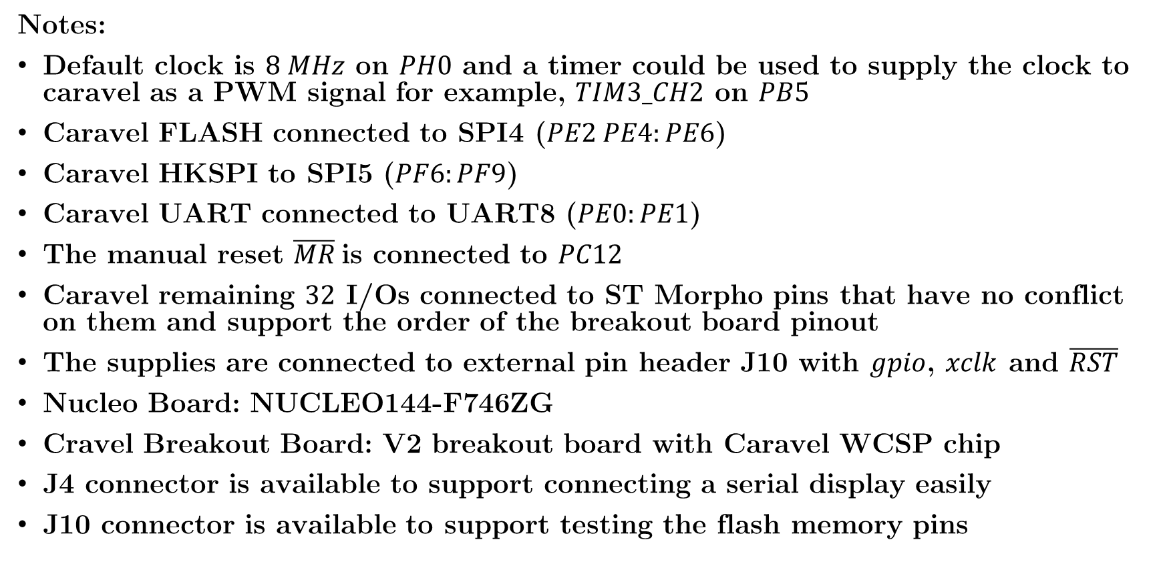
Caravel + Nucleo Board Schematic
Notes:
Default clock is $8 MHz$ on $PH0$ and a timer could be used to supply the clock to caravel as a PWM signal for example, $TIM3_CH2$ on $PB5$
Caravel FLASH connected to SPI4 ($PE2 PE4:PE6$)
Caravel HKSPI to SPI5 ($PF6:PF9$)
Caravel UART connected to UART8 ($PE0:PE1$)
The manual reset $\overline{MR}$is connected to $PC12$
Caravel remaining $32$ I/Os connected to ST Morpho pins that have no conflict on them and support the order of the breakout board pinout
The supplies are connected to external pin header J10 with $gpio$, $xclk$ and $\overline{RST}$
Nucleo Board: NUCLEO144-F746ZG
Cravel Breakout Board: V2 breakout board with Caravel WCSP chip
J4 connector is available to support connecting a serial display easily
J10 connector is available to support testing the flash memory pins

Slide 14
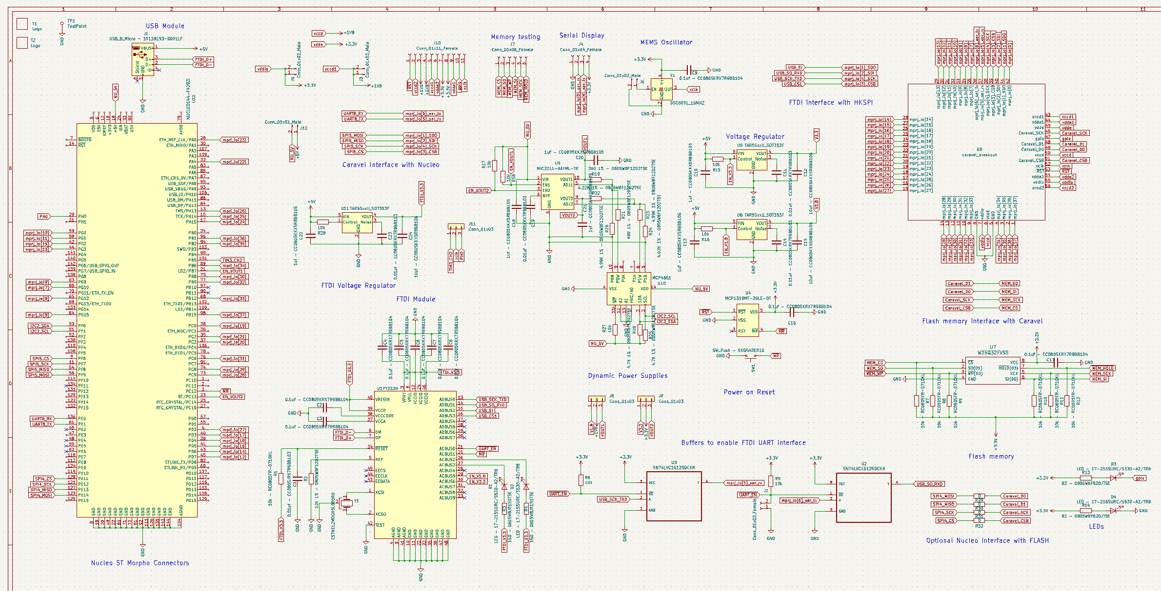
Caravel + Nucleo Board Schematic

Slide 15
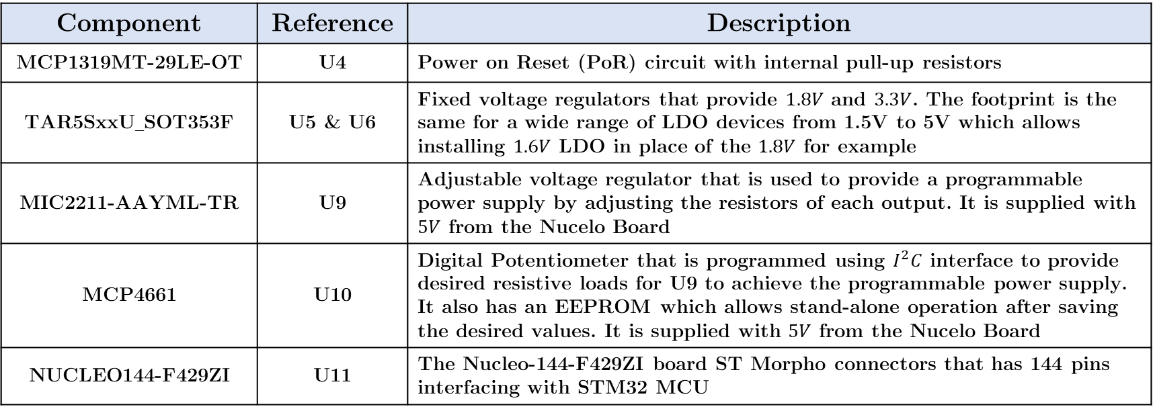
Caravel + Nucleo Board Components
Component | Reference | Description
MCP1319MT-29LE-OT | U4 | Power on Reset (PoR) circuit with internal pull-up resistors
TAR5SxxU_SOT353F | U5 & U6 | Fixed voltage regulators that provide $1.8V$ and $3.3V$. The footprint is the same for a wide range of LDO devices from 1.5V to 5V which allows installing $1.6V$ LDO in place of the $1.8V$ for example
MIC2211-AAYML-TR | U9 | Adjustable voltage regulator that is used to provide a programmable power supply by adjusting the resistors of each output. It is supplied with $5V$ from the Nucelo Board
MCP4661 | U10 | Digital Potentiometer that is programmed using $I^{2}C$ interface to provide desired resistive loads for U9 to achieve the programmable power supply. It also has an EEPROM which allows stand-alone operation after saving the desired values. It is supplied with $5V$ from the Nucelo Board
NUCLEO144-F429ZI | U11 | The Nucleo-144-F429ZI board ST Morpho connectors that has 144 pins interfacing with STM32 MCU

Slide 16
Caravel + Nucleo Pinout
Caravel BB Pin | ST Morpho Pin
1: io[37] | 98: PB15
2: io[36] | 96: PB1
3: io[35] | 94: PB2
4: io[34] | 89: PB6
5: GND | GND
6: vccd | -
7: vddio | -
8: GND | GND
9: io[33] | 88: PB12
10: io[32] | 77: PB9
11: io[31] | 76: PC6
12: io[30] | 75: PB8
13: io[29] | 74: PC8
14: io[28] | 73: PC9
Caravel BB Pin | ST Morpho Pin
15: io[27] | 4: PD2
16: io[26] | 13: PA13
17: io[25] | 15: PA14
18: io[24] | 17: PA15
19: io[23] | 28: PA0
20: io[22] | 32: PA4
21: io[21] | 35: PC2
22: io[20] | 37: PC3
23: io[19] | 38: PC0
24: io[18] | 39: PD4
25: io[17] | 40: PD3
26: io[16] | 41: PD5
27: io[15] | 42: PG2
28: io[14] | 43: PD6

Slide 17
Caravel + Nucleo Pinout
Caravel BB Pin | ST Morpho Pin
29: io[13] | 44: PG3
30: io[12] | 45: PD7
31: io[11] | 58: PG1
32: io[10] | 59: PG0
33: io[9] | 63: PG9
34: io[8] | 64: PG15
35: io[7] | 66: PG10
36: io[6]/tx | 136:PE0
37: io[5]/rx | 61: PE1
38: io[4]/SCK | 11: PF7
39: io[3]/CSB | 9: PF6
40: io[2]/SDI | 54: PF8
41: io[1]/SDO | 56: PF9
42: io[0] | 65: PG12
Caravel BB Pin | ST Morpho Pin
43: vccd1 | -
44: vdda1 | -
45: vdda | -
46: Caravel/SCK | 121: PE12
47: gpio | -
48: Caravel/D1 | 127: PE13
49: Caravel/D0 | 123: PE14
50: vccd | -
51: Caravel/CSB | 128: PE11
52: xclk | -
53: NRST | -
54: vdda2 | -
55: vddio | -
56: vccd2 | -

Slide 18
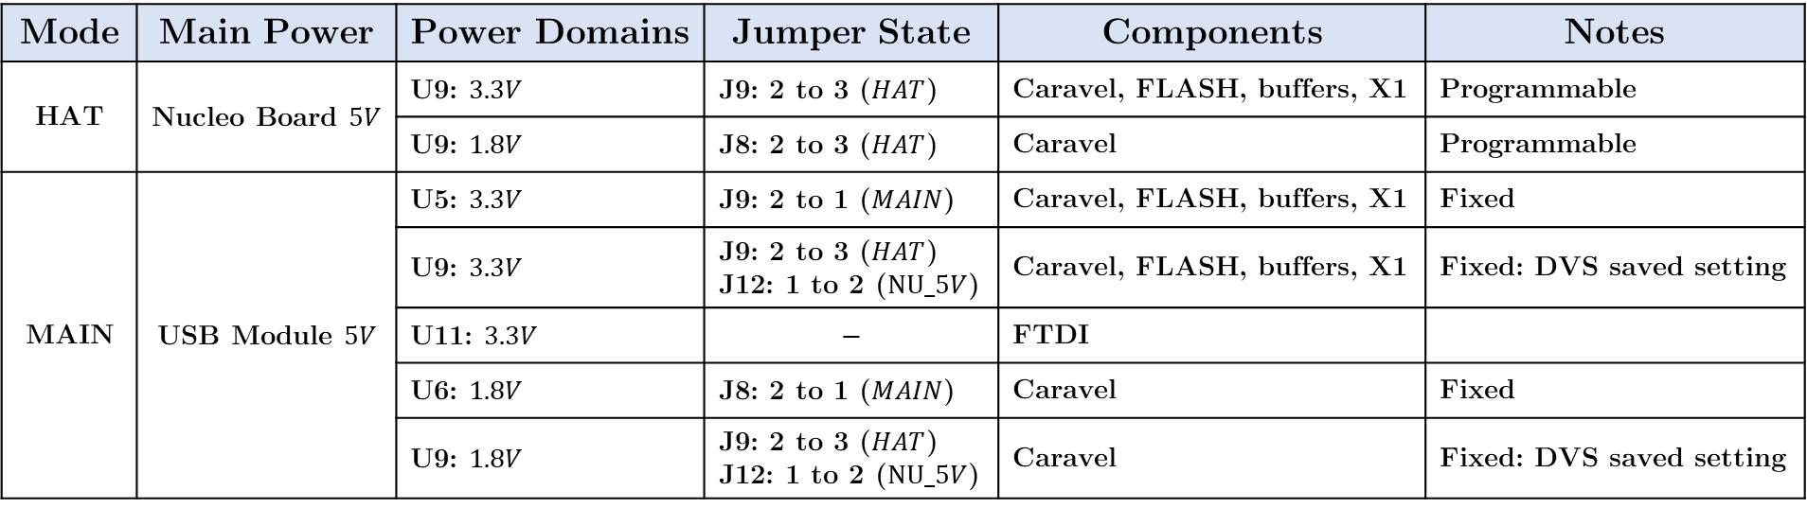
Caravel + Nucleo Board Power Supply
Mode | Main Power | Power Domains | Jumper State | Components | Notes
HAT | Nucleo Board $5V$ | U9: $3.3V$ | J9: 2 to 3 ($HAT$) | Caravel, FLASH, buffers, X1 | Programmable
 |  | U9: $1.8V$ | J8: 2 to 3 ($HAT$) | Caravel | Programmable
MAIN | USB Module $5V$ | U5: $3.3V$ | J9: 2 to 1 ($MAIN$) | Caravel, FLASH, buffers, X1 | Fixed
 |  | U9: $3.3V$ | J9: 2 to 3 ($HAT$) J12: 1 to 2 ($NU_5V$) | Caravel, FLASH, buffers, X1 | Fixed: DVS saved setting
 |  | U11: $3.3V$ | $$−$$ | FTDI
 |  | U6: $1.8V$ | J8: 2 to 1 ($MAIN$) | Caravel | Fixed
 |  | U9: $1.8V$ | J9: 2 to 3 ($HAT$) J12: 1 to 2 ($NU_5V$) | Caravel | Fixed: DVS saved setting
Both modes support supplying $3.3V$ and $1.8V$ externally through J10 pins and leaving J8 and J9 floating

Slide 19
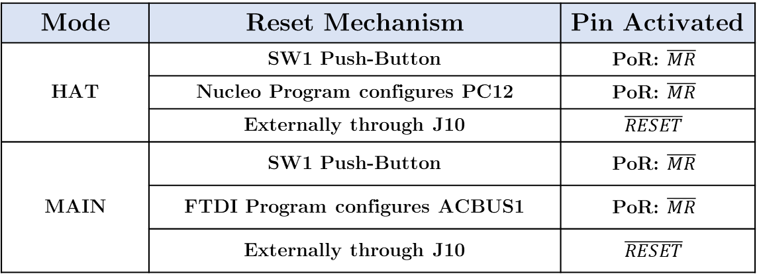
Caravel + Nucleo Board Reset
Mode | Reset Mechanism | Pin Activated
HAT | SW1 Push-Button | $$\text{PoR}\text{: }\overline{MR}$$
 | Nucleo Program configures PC12 | $$\text{PoR}\text{: }\overline{MR}$$
 | Externally through J10 | $$\overline{RESET}$$
MAIN | SW1 Push-Button | $$\text{PoR}\text{: }\overline{MR}$$
 | FTDI Program configures ACBUS1 | $$\text{PoR}\text{: }\overline{MR}$$
 | Externally through J10 | $$\overline{RESET}$$

Slide 20
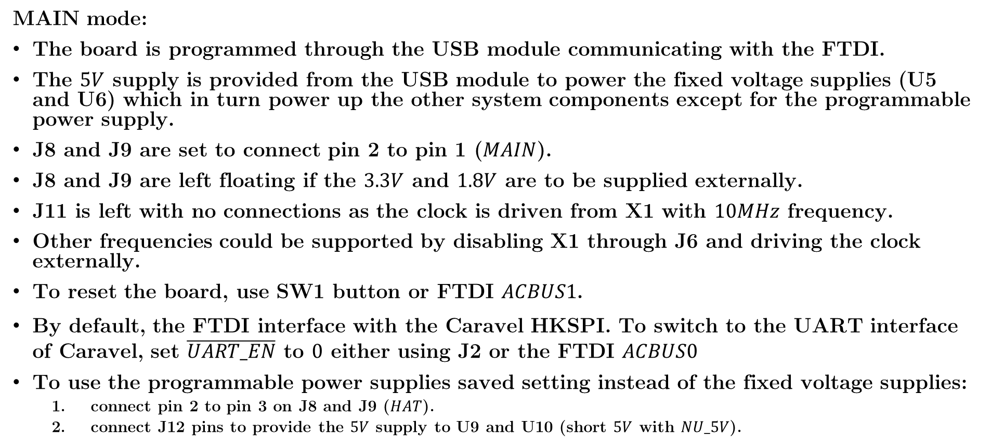
Caravel + Nucleo Board Modes
MAIN mode:
The board is programmed through the USB module communicating with the FTDI.
The $5V$ supply is provided from the USB module to power the fixed voltage supplies (U5 and U6) which in turn power up the other system components except for the programmable power supply.
J8 and J9 are set to connect pin 2 to pin 1 ($MAIN$).
J8 and J9 are left floating if the $3.3V$ and $1.8V$ are to be supplied externally.
J11 is left with no connections as the clock is driven from X1 with $10MHz$ frequency.
Other frequencies could be supported by disabling X1 through J6 and driving the clock externally.
To reset the board, use SW1 button or FTDI $ACBUS1$.
By default, the FTDI interface with the Caravel HKSPI. To switch to the UART interface of Caravel, set $\overline{UART_EN}$ to $0$ either using J2 or the FTDI $ACBUS0$
To use the programmable power supplies saved setting instead of the fixed voltage supplies:
connect pin 2 to pin 3 on J8 and J9 ($HAT$).
connect J12 pins to provide the $5V$ supply to U9 and U10 (short $5V$ with $NU_5V$).

Slide 21
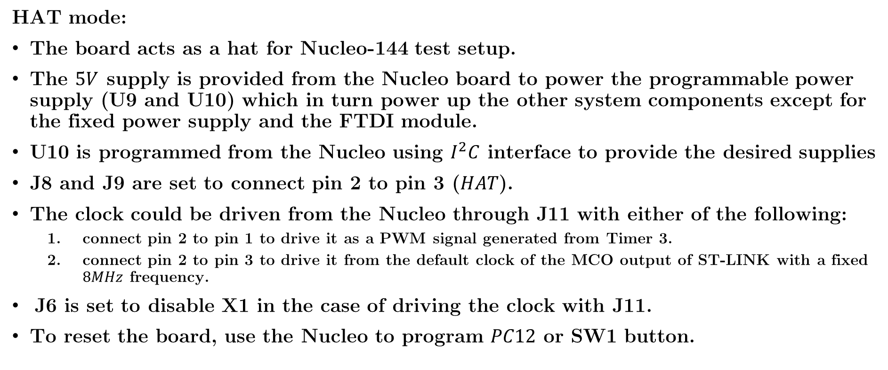
Caravel + Nucleo Board Modes
HAT mode:
The board acts as a hat for Nucleo-144 test setup.
The $5V$ supply is provided from the Nucleo board to power the programmable power supply (U9 and U10) which in turn power up the other system components except for the fixed power supply and the FTDI module.
U10 is programmed from the Nucleo using $I^{2}C$ interface to provide the desired supplies
J8 and J9 are set to connect pin 2 to pin 3 ($HAT$).
The clock could be driven from the Nucleo through J11 with either of the following:
connect pin 2 to pin 1 to drive it as a PWM signal generated from Timer 3.
connect pin 2 to pin 3 to drive it from the default clock of the MCO output of ST-LINK with a fixed $8MHz$ frequency.
\J6 is set to disable X1 in the case of driving the clock with J11.
To reset the board, use the Nucleo to program $PC12$ or SW1 button.

Slide 22
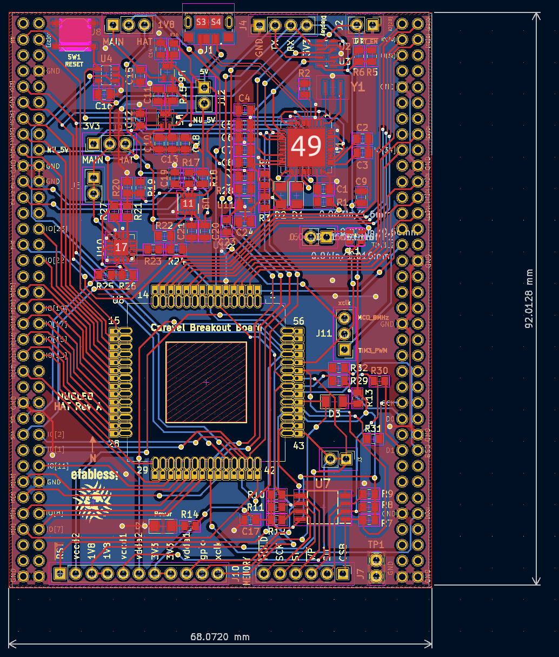
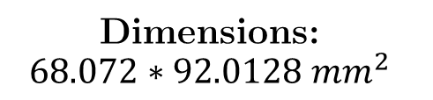
Caravel + Nucleo Board PCB
Dimensions:
$$68.072∗92.0128 mm^{2}$$

